Slide 1
CSCE5560 SECURE E-COMMERCE
FINAL PROJECT PRESENTATION
WEBSITE – ”SHOP FROM HOME”

Slide 2
TEAM & ROLES:
Harshith Rapala- Works on security and payment.
Venkata Sai Bhargava Reddy, Cheruku - Works on design and testing.
Dhaman Kumar Kakke - Works on development of Security (Project Manager).
Ravi Teja Sankuratri - Works on database and design (user interface).
Sai Krishna Abburi - Works on payment system and testing.

Slide 3
INTRODUCTION/PROMINENT FEATURES:
Our website name is “SHOP FROM HOME ”.
This website mainly focuses on daily needs of people like grocery and deliver them to people in this tough situation.
We provide all grocery products and some other essential products through our website.
The groceries will be categorized based on the products which will help people to find them easily.

Slide 4
TECHNOLOGIES USED
WordPress
PHPMyAdmin
MySql
MySql Workbench

Slide 5

IMPLEMENTATION ISSUES
We choose WordPress as it an easy and quick to learn content management system.
There were several challenges faced by the team in the development phase whereas the Planning phase had been a lot smoother.
The CSE web server runs PHP version 5.3.10. But the latest WordPress version 5.4 requires at least 5.6.2 version of PHP. As a resolution to the above issue we had to install WordPress 5.1.4 which offered further issues (like security).

Slide 6

Database, shopping cart and payment gateway
Shopping cart
In this cart it add the total amount of the products and sums it with the tax and the the delivery fees that are applicable . Discounts via coupon codes are subtracted and then displays a total amount due.
Theme
We Used New Shop ECOMMERCE theme in WOOCOMMERCE PLUGIN.
Payment gateway
It is the final stage for customer to acquire the product.
Database ​
All the products are retrieved from database .Whenever the customer places an order, the transaction is also updated in the Database.

Slide 7

SESSION MANAGEMENT
Login cookies contain authentication details which are used when a user logs into the WordPress admin dashboard.
On login, WordPress uses the wordpress_[hash] cookie to store authentication details (limited to the /wp-admin/ area).
After login, WordPress stores the timestamp and the identity of the logged in user.
As the access to cookies is limited to the wp-admin area, we made sure that admin account is inaccessible to the outsider.
To implement this the wordpress/wp-admin url has been changed to a new url which will remain confidential to the team.

Slide 8
Testing.
An Application testing is done to verify the functionalities developed across the site such as page specific functionalities- like cart updating, My Account- Resetting password and updating address etc., Searching products based on categories.

Slide 9
SECURITY CHALLENGES/PREVENTIVE MEASURES:
We do not have SSL Certificate enable on our website since we donot have access to Apache 2 directory on our CSE server. As a result SSL/TLS encryption is not possible.
To prevent an SQL injection attack:
we changed the default WordPress prefix of the Database.
Installed a plugin to build website application Firewall(WAF).
To prevent an XSS attack we installed a plugin to Block/Remove the different Entities in the URL like [,{,].It also strips the HTML in $_GET variable in PHP. So, wherever the $_GET is used in either theme or plugin it will escaped HTML.

Slide 10
Security measures.
prevented brute force attack.
prevented Privilege Escalation Attack.
Prevented plugin issues by providing high security.

Slide 11
Customer trust and satisfaction
Warranties and guaranties: Nothing builds consumer confidence like a money-back guarantee. We provide money back guarantee for wrongly delivered products.
Design quality: professional appearance feels solid; clear navigation conveys respect for customers and an implied promise of good service.
We incorporated a dynamic cart display.
We included some coupons for people who order greater than 200. coupon name “morethan200”
All the transactions across the site have been secured by using PayPal transaction system
Our site's simple navigation facilitates ease of use.

Slide 12
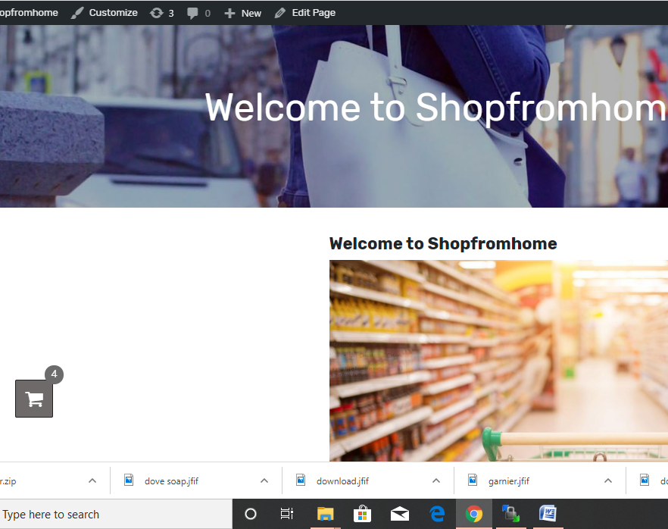
Welcome page

Slide 13
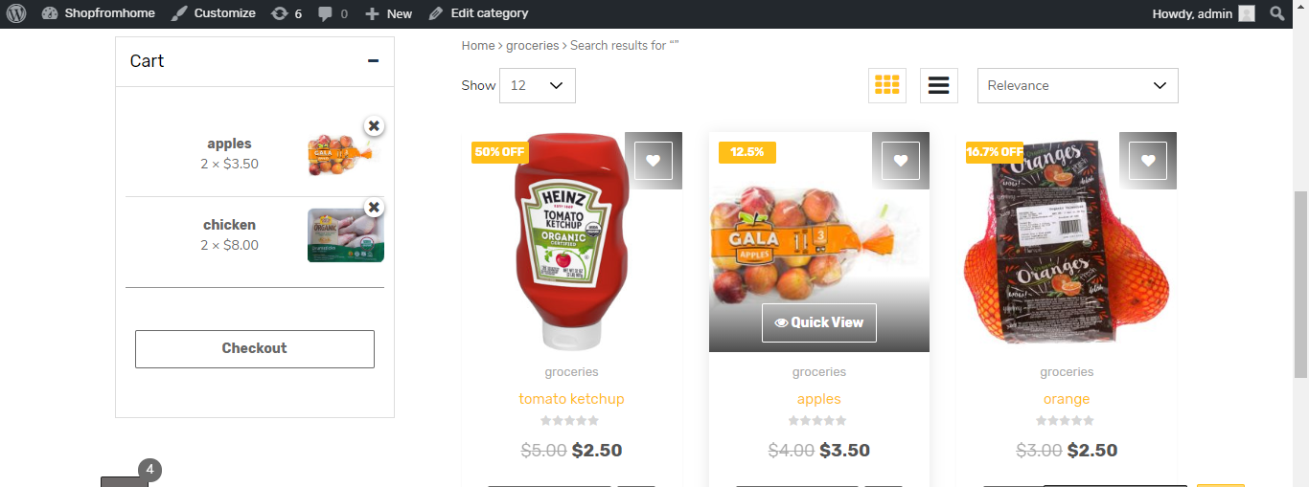
Products Page

Slide 14
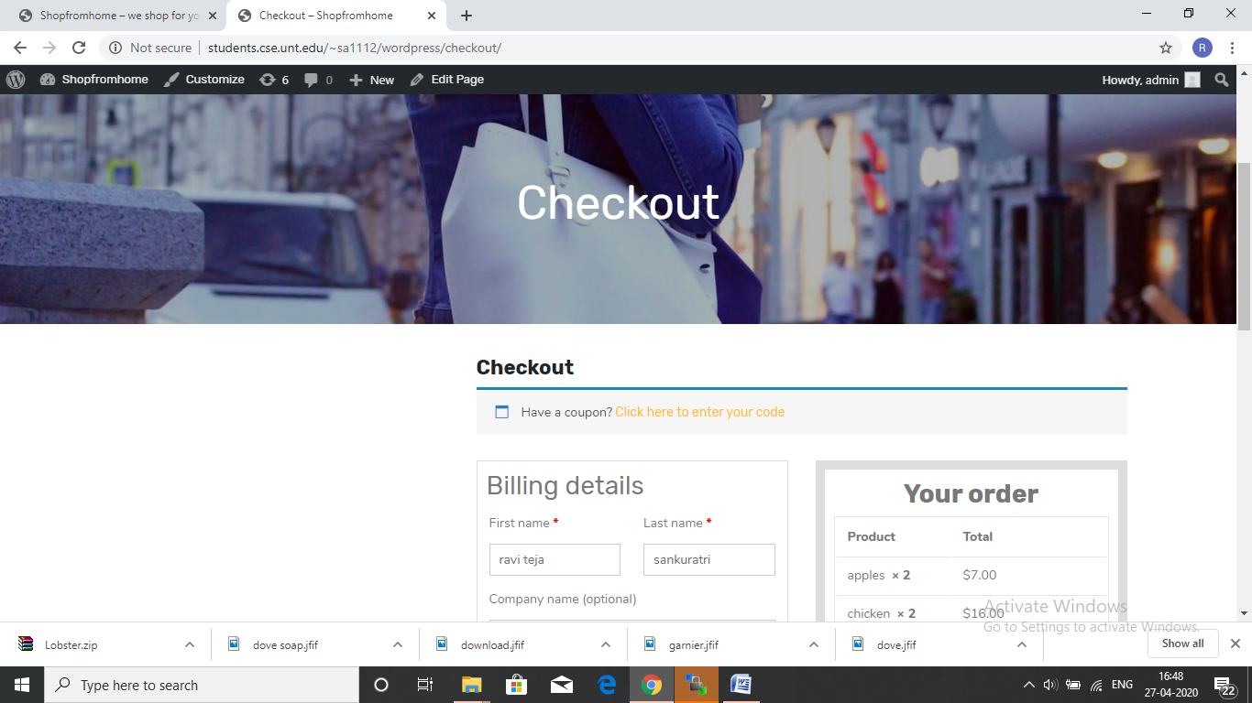
Checkout Page

Slide 15

THANK YOU

